Slide 1

AutomationML - Engine
Extended version
03.04.2012
Author: Dr.-Ing. Rainer Drath, ABB Corporate Research Germany
state: 03.04.2012

Slide 2
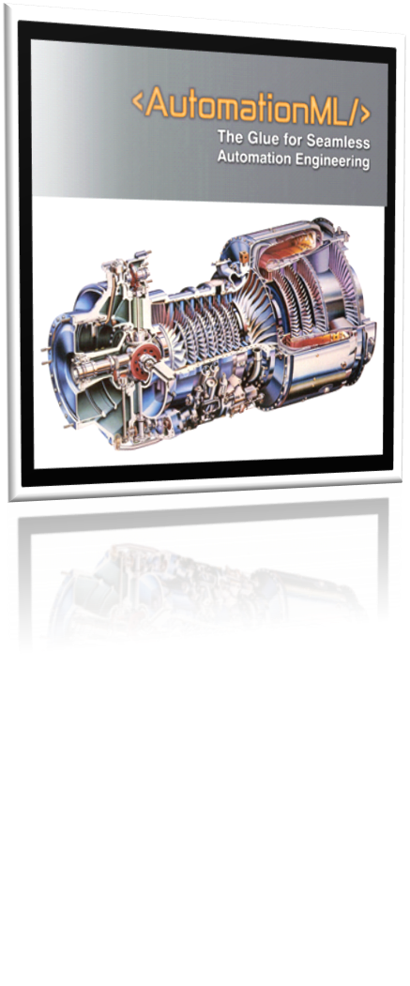
Overview
What is the AutomationML Engine
Software Representation of CAEX
Provides software functionality to create and manipulate CAEX files according to IEC62424 and IEC 62714.
Validates the CAEX files against basic rules according to IEC 62714.
Is the software foundation for a variety of AutomationML software, e.g. for the AutomationML Editor, importer/exporter in the AutomationML community
Test environment
Windows 7, Visual Studio 2008, .Net Framework 3.5
this software may run in Visual Studio 2010 and higher .Net Frameworks
AutomationML – Engine Extensions 2.0.1

Slide 3
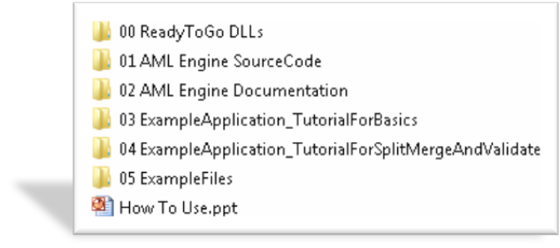
Folders
  00 ReadyToGo DLLs
  contains ready to go dlls for direct binding into your .Net projects
  01 AML Engine Source Code
  contains the source code of the AML Engine including extensions
  02 AML Engine Documentation
  contains a chm help file
  03 ExampleApplication_TutorialForBasics
  contains an example application demonstrating
  - how to create a CAEX File
  - how to save and store a CAEX file
  - how to validate a CAEX file
  - how to label a CAEX file
  04 ExampleApplication_TutorialForSplitMergeAndValidate
  contains an example application demonstrating how to split and merge CAEX files
  05 ExampleFiles
  Contains a set of example CAEX files with different kinds of typical errors in order to demonstrate the validation capabilities of the AutomationML Engine
AutomationML – Engine Extensions 2.0.1

Slide 4
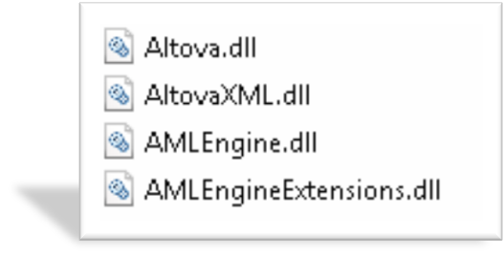

DLLs
Bind these files into your .Net project
AutomationML – Engine Extensions 2.0.1

Slide 5
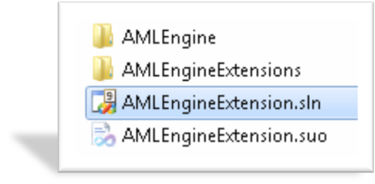
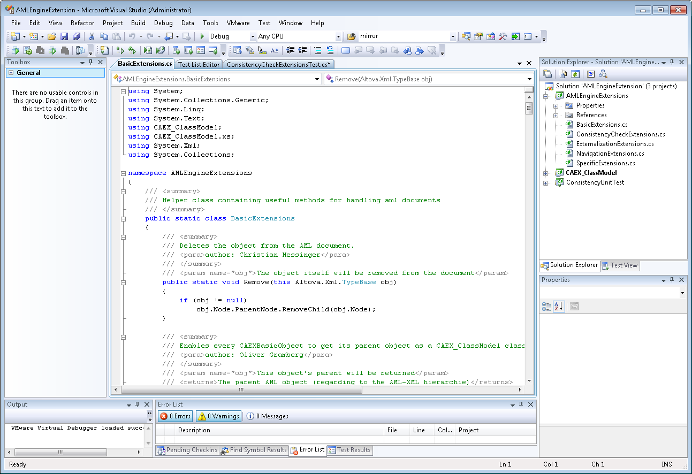
AML Engine Source Code*
Open the AMLEngineExtension.sln
* Available to AutomationML e.V. members only
AutomationML – Engine Extensions 2.0.1

Slide 6
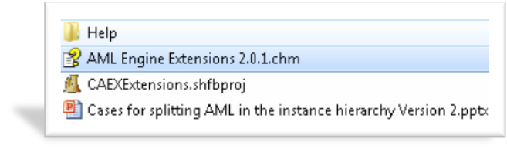
Documentation
AML Engine Extension 2.0.1.chm
  a complete developer documentation help file
CAEXExtensions.shfbpro
  SandCastle project which allows creating the documentation automatically
Cases for splitting AML … pptx
  A Powerpoint presentation presenting some use cases for splitting CAEX files
AutomationML – Engine Extensions 2.0.1

Slide 7
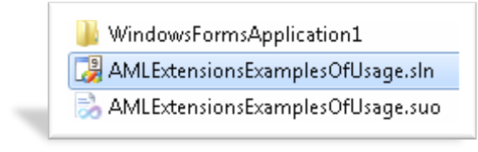
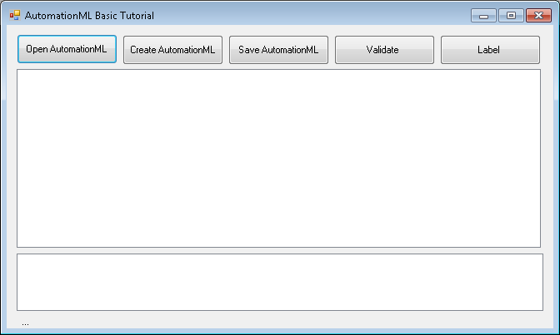
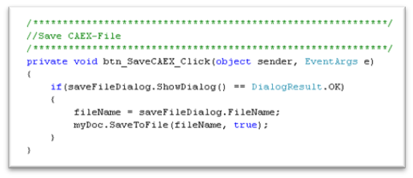
ExampleApplication Basic Tutorial
Open the AMLExtensionsExaplesOfUsage.sln
This solution provides an example application with code snippets for basic applications
1
1
AutomationML – Engine Extensions 2.0.1

Slide 8
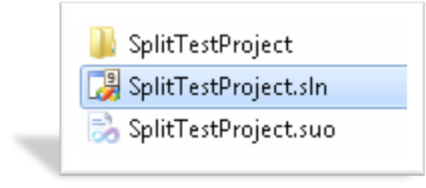
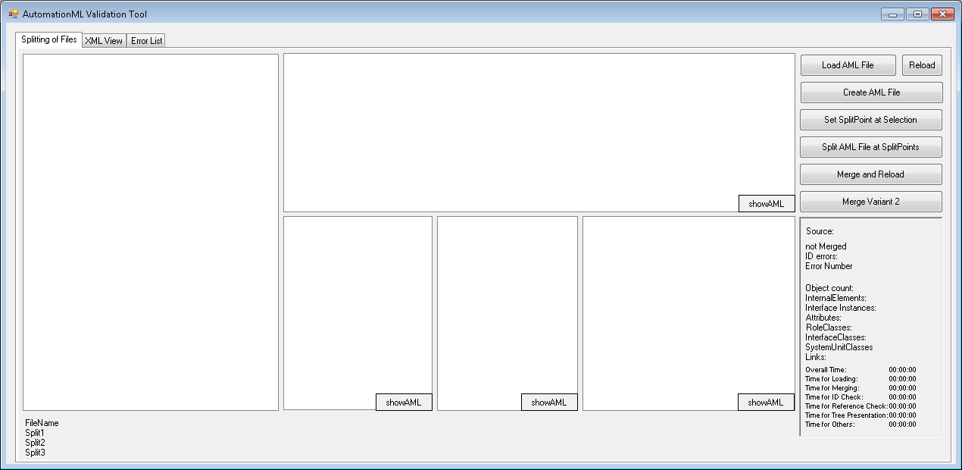
ExampleApplication SplitMergeAndValidate
Provides an example application with code snippets for splitting, merging and validation
AutomationML – Engine Extensions 2.0.1

Slide 9
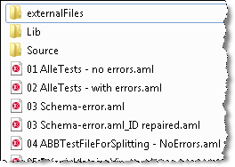
Example Files
A set of example files containing a set of errors
AutomationML – Engine Extensions 2.0.1

